Slide 1
Depositing parish records at Lancashire Archives
Keri Nicholson, Collections Archivist

Slide 2
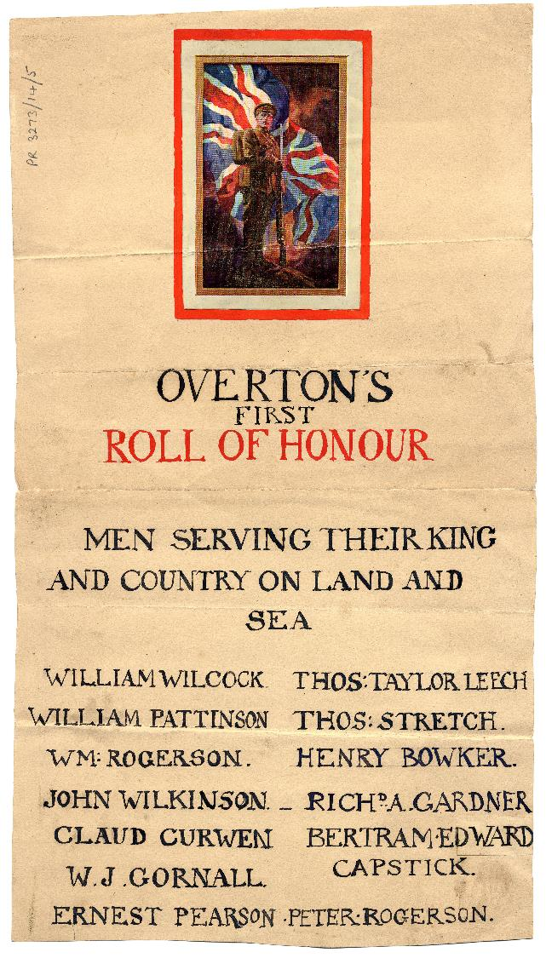
Parish collections at Lancashire Archives
The first deposit of parish records, for Whalley St Mary and All Saints, arrived in 1941.
We have been caring for church records for over 80 years, but the relationship was formalised in the late 1970s under the Parochial Register and Records Measure. As a Diocesan Record Office we are responsible for all parishes in the Diocese of Blackburn, as well as some in the Diocese of Liverpool and Diocese of Leeds.
For much of its lifetime the church has been at the centre of people’s lives, and this is reflected in the large, name rich collections we already hold.
Parish records typically make up about 10% of all holdings in county record offices.
You can view descriptions of the parish records we hold in our online catalogue, LANCAT.

Slide 3
What parish records would we like?
Our building is full and we are having to start moving collections offsite, which is forcing us to be more selective about what we accept.
The measure doesn’t really define what should be kept, but there is records management guidance produced by the Church of England, Keep or bin?
Subject | Must keep | May keep | Should dispose of
Church services | Registers of baptisms, marriages, burials, banns, confirmations and services | Registers of marriage blessings, funerals/interments, service sheets and photos of special services | Certificate counterfoils, copy certificates and applications
Church buildings and property | Former terriers, inventories and log books; faculties and accompanying papers, photos, plans and drawings; plans etc relating to major alterations; heritage reports | A logbook or scrapbook recording parish events
Parish admin | Signed PCC minutes and accompanying reports | Letters and reports re major developments; questionnaire returns; parish profile; maps of the parish; electoral rolls; parish magazines | Correspondence and papers re routine parish admin
Parish finance | Annual accounts of all PCC funds |  | All other supporting financial records (after 7 years)

Slide 4
How to deposit records at Lancashire Archives
Previously archives staff would carry out surveys of material held in parishes, but we don't have the capacity for this now, so we will be relying on you to tell us what you have.
When you are ready to make a deposit, please contact us first. Send us a basic list of the material you would like to add to the archive. We can supply a template for this.
For the sake of clarity, we will take all parish registers, signed PCC minutes and annual accounts.
Anything else on the list will be compared against our existing collections before we confirm with you what we would like to accept.
We will arrange a date for you to bring in the material to Preston.
Once processed, we will send out a receipt for you to sign and return to us (retaining one copy for your records).

Slide 5
What about digital records?
In theory this guidance should apply regardless of the format of your church records, whether they are physical or digital.
In reality digital records are more complex to preserve.
Lancashire Archives have just procured a digital preservation solution, Preservica. We are currently learning more about how to use it, and hope to issue guidance for digital records in the near future.
As a starting point it would be helpful to know more about which parish records are now being produced in a digital format.

Slide 6
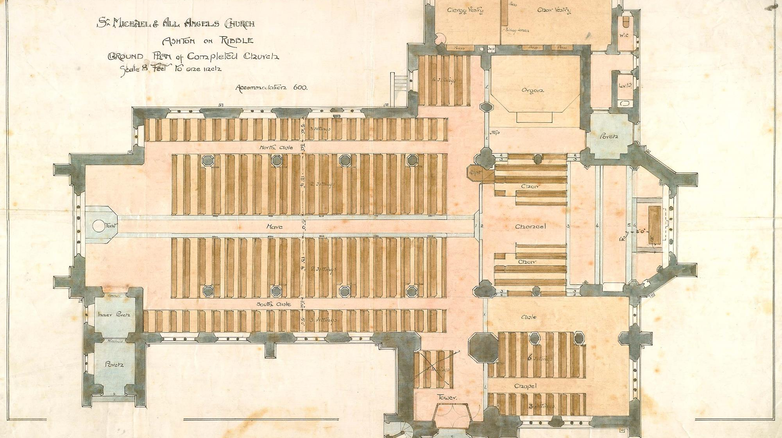
Any questions?

